Slide 1

CUDA Programming Model
Xing Zeng, Dongyue Mou

Slide 2
Outline
  Introduction
  Motivation
  Programming Model
  Memory Model
  CUDA API
  Example
  Pro & Contra
  Trend

Slide 3
Outline
  Introduction
  Motivation
  Programming Model
  Memory Model
  CUDA API
  Example
  Pro & Contra
  Trend

Slide 4
Introduction
What is CUDA?
- Compute Unified Device Architecture.
- A powerful parallel programming model for issuing and managing computations on the GPU without mapping them to a graphics API.
  Heterogenous - mixed serial-parallel programming
  Scalable - hierarchical thread execution model
  Accessible - minimal but expressive changes to C

Slide 5
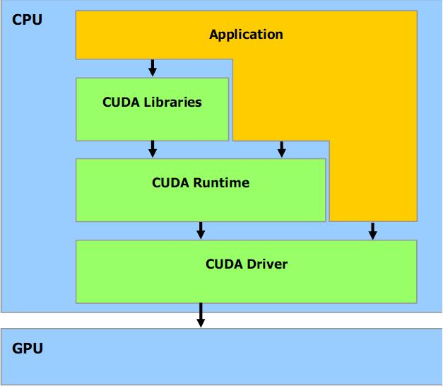
Introduction
Software Stack:
  Libraries:
CUFFT & CUBLAS
  Runtime:
Common component
Device component
Host component
  Driver:
Driver API

Slide 6
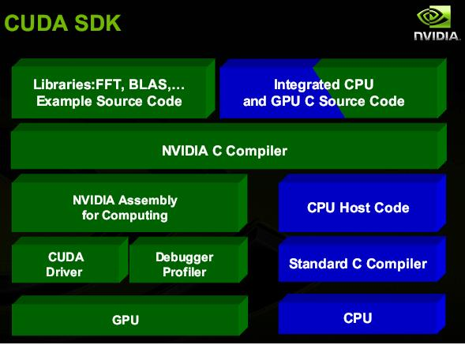
Introduction
CUDA SDK

Slide 7
Outline
  Introduction
  Motivation
  Programming Model
  Memory Model
  CUDA API
  Example
  Pro & Contra
  Trend

Slide 8
Motivation
GPU Programming Model
GPGPU Programming Model
CUDA Programming Model

Slide 9
Motivation
GPU Programming Model
GPGPU Programming Model
CUDA Programming Model

Slide 10
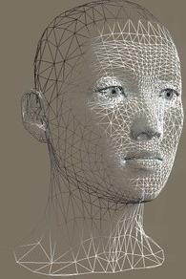
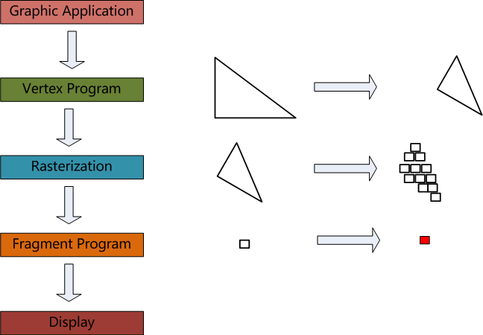

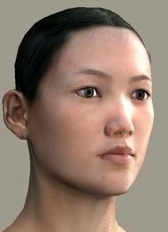
Motivation
GPU Programming Model for Graphics

Slide 11
Motivation
GPU Programming Model
GPGPU Programming Model
CUDA Programming Model

Slide 12
Motivation
GPGPU Programming Model
Trick the GPU into general-purpose
computing by casting problem as graphics
  Turn data into images ("texture maps")
  Turn algorithms into image synthesis ("rending passes")
Drawback:
  Tough learning curve
  potentially high overhead of graphics API
  highly constrained memory layout & access model
  Need for many passes drives up bandwidth consumption

Slide 13
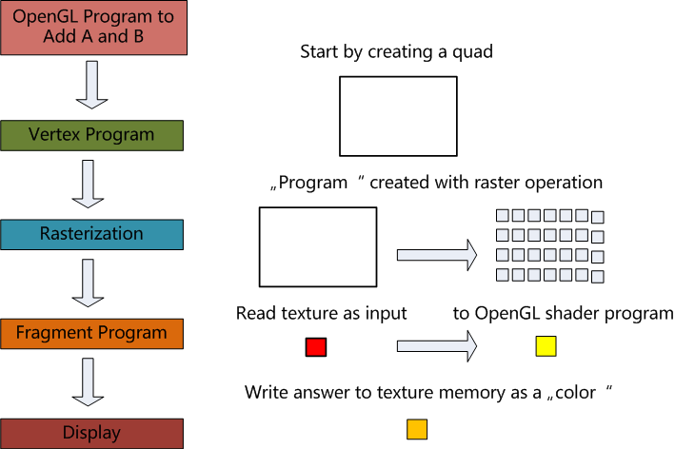
Motivation
GPGPU Programming to do A + B

Slide 14
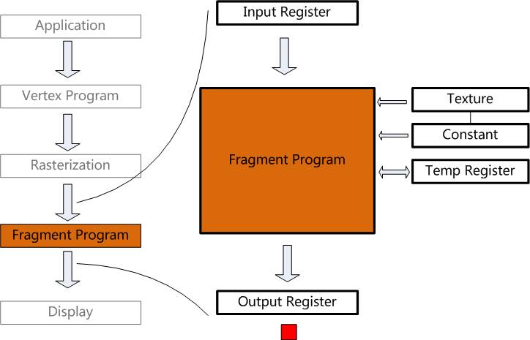
Motivation
What's wrong with GPGPU 1
APIs are specific to Graphics
Limited texture size and dimension
Limited Instruction set
No thread Communication
Limited local storage
Limited shader outputs
No scatter

Slide 15
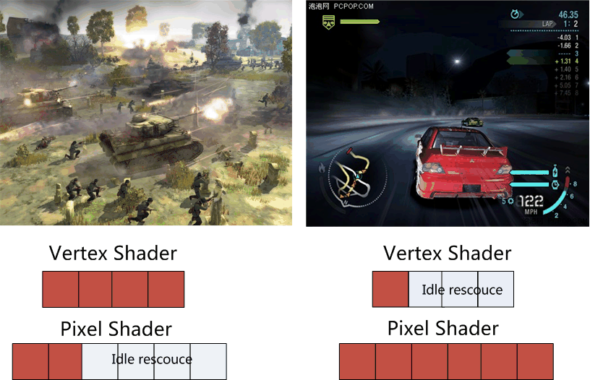
Motivation
What's wrong with GPGPU 2

Slide 16
Motivation
GPU Programming Model
GPGPU Programming Model
CUDA Programming Model

Slide 17
Outline
  Introduction
  Motivation
  Programming Model
  Memory Model
  CUDA API
  Example
  Pro & Contra
  Trend

Slide 18
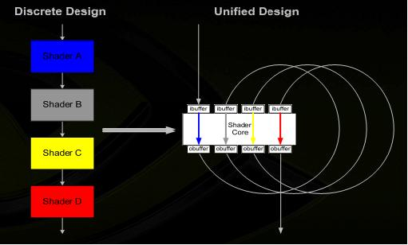
Programming Model
CUDA: Unified Design
Advantage:
HW: fully generally data-parallel arch-
tecture.
  General thread launch
  Global load-store
  Parallel data cache
  Scalar architecture
  Integers, bit operation
SW: program the GPU in C
  Scalable data parallel execuation/
memory model
  C with minimal yet powerful
extensions

Slide 19
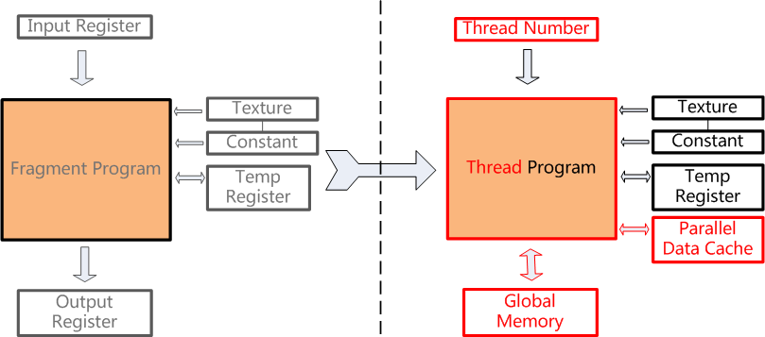
Motivation
From GPGPU to CUDA Programming Model

Slide 20
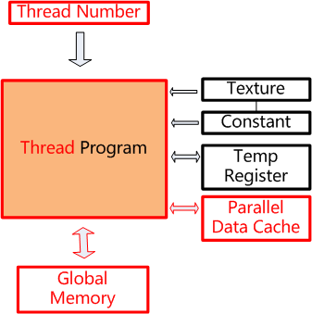
Programming Model
Feature 1:
  Thread not pixel
  Full Integer and Bit Instructions
  No limits on branching, looping
  1D, 2D, 3D threadID allocation
Feature 2:
  Fully general load/store to
GPU memory
  Untyped, not fixed texture types
  Pointer support
Feature 3:
  Dedicated on-chip memory
  Shared between threads for
inter-threads communication
  Explicitly managed
  As fast as registers

Slide 21
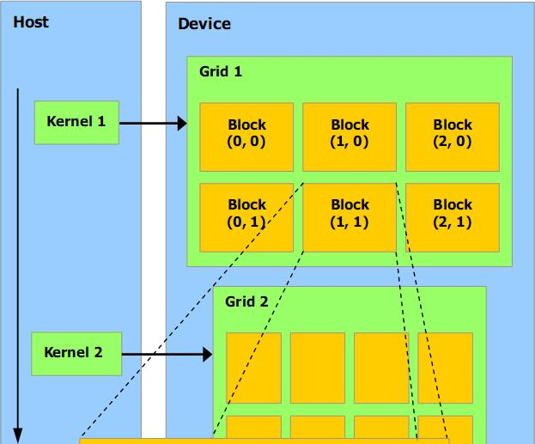
Programming Model
Important Concepts:
  Device: GPU, viewed as a
co-processor.
  Host: CPU
  Kernel: data-parallel,
computed-intensive positions
of application running on the
device.

Slide 22
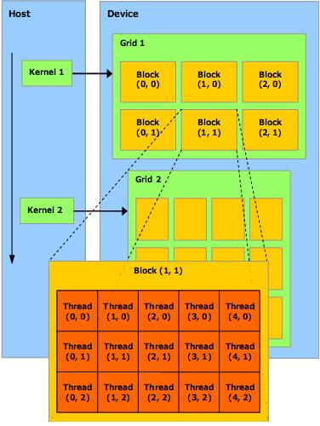
Programming Model
Important Concepts:
  Thread: basic execution unit
  Thread block:
A batch of thread. Threads
in a block cooperate together,
efficiently share data.
Thread/block have unique id
  Grid:
A batch of thread block.
that excuate same kernel.
Threads in different block in
the same grid cannot directly
communicate with each other

Slide 23
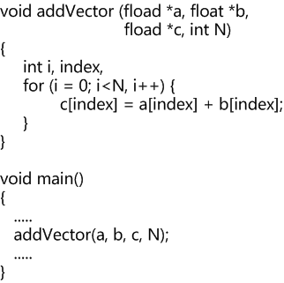
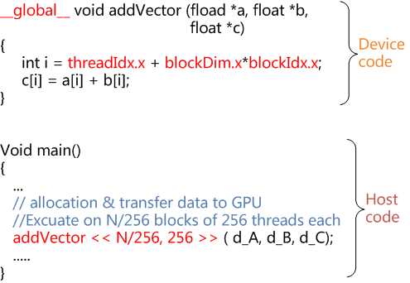
Programming Model
Simple example ( Matrx addition ):
cpu c program: cuda program:

Slide 24
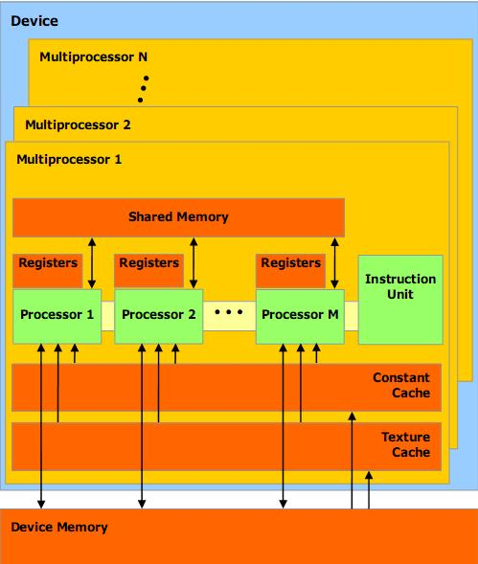
Programming Model
Hardware implementation:
A set of SIMD
Multiprocessors with On-
Chip shared memory

Slide 25
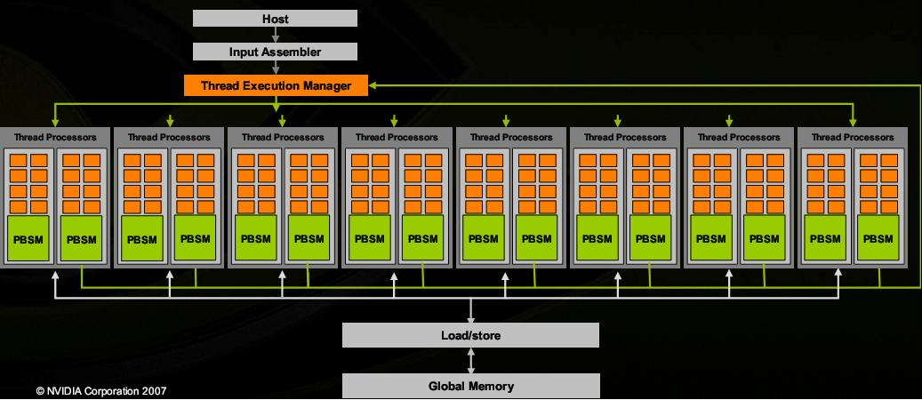
Programming Model
G80 Example:
  16 Multiprocessors, 128 Thread Processors
  Up to 12,288 parallel threads active
  Per-block shared memory accelerates processing.

Slide 26

Programming Model
Streaming Multiprocessor (SM)
  Processing elements
    8 scalar thread processors
    32 GFLOPS peak at 1.35GHz
    8192 32-bit registers (32KB)
    usual ops: float, int, branch...
  Hardware multithreading
    up to 8 blocks (3 active) residents at once
    up to 768 active threads in total
  16KB on-chip memory
    supports thread communication
    shared amongst threads of a block

Slide 27
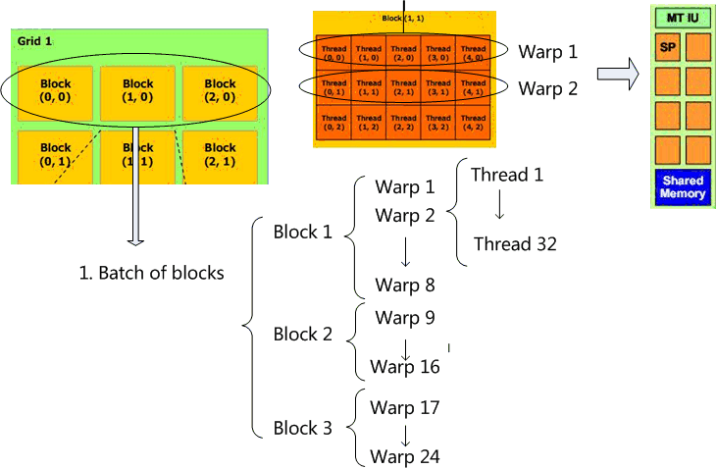
Programming Model
Execution Model:

Slide 28
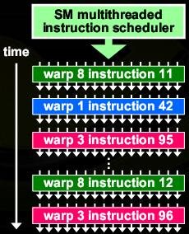
Programming Model
Single Instruction Multiple Thread (SIMT) Execution:
  Groups of 32 threads formed
into warps
    always executing same instruction
    share instruction fetch/dispatch
    some become inactive
when code path diverges
    hardware automatically handles divergence
  Warps are primitive unit of scheduling
    pick 1 of 24 warps for each instruction slot.
    all warps from all active blocks are time-sliced

Slide 29
Outline
  Introduction
  Motivation
  Programming Model
  Memory Model
  CUDA API
  Example
  Pro & Contra
  Trend

Slide 30
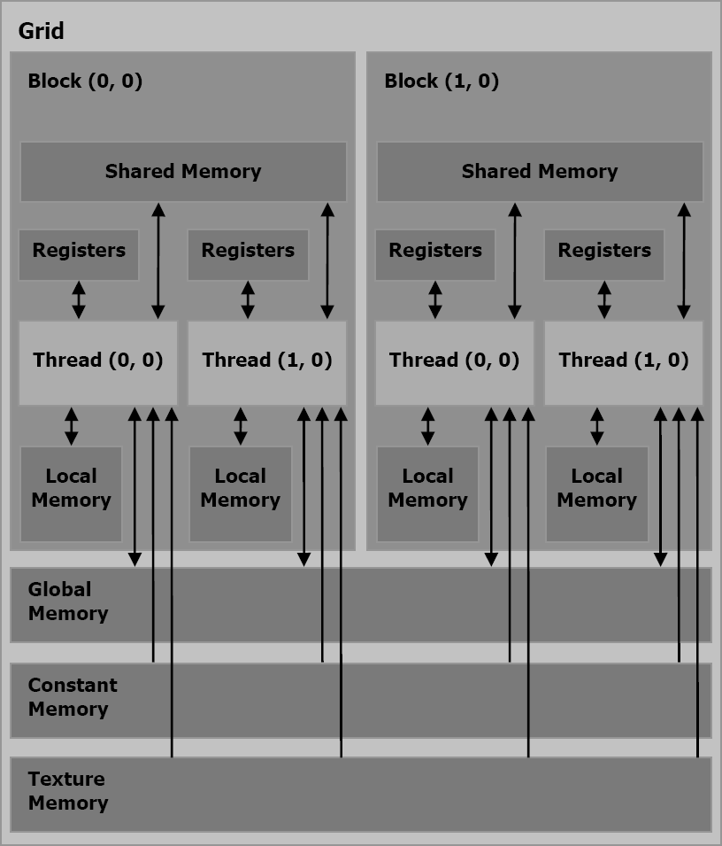
Memory Model
There are 6 Memory Types :

Slide 31
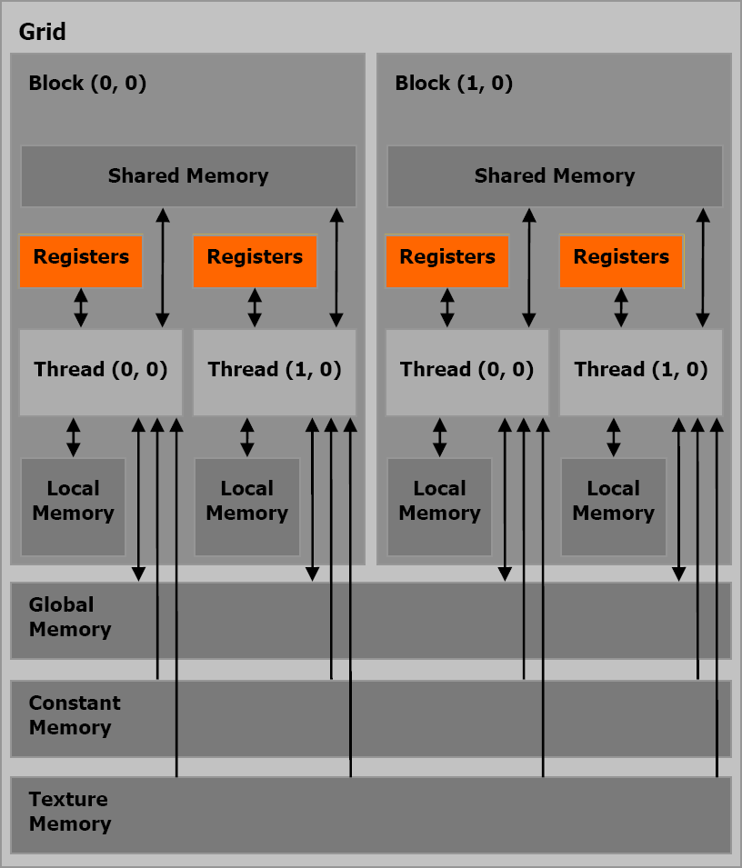
Memory Model
There are 6 Memory Types :
  Registers
    on chip
    fast access
    per thread
    limited amount
    32 bit

Slide 32
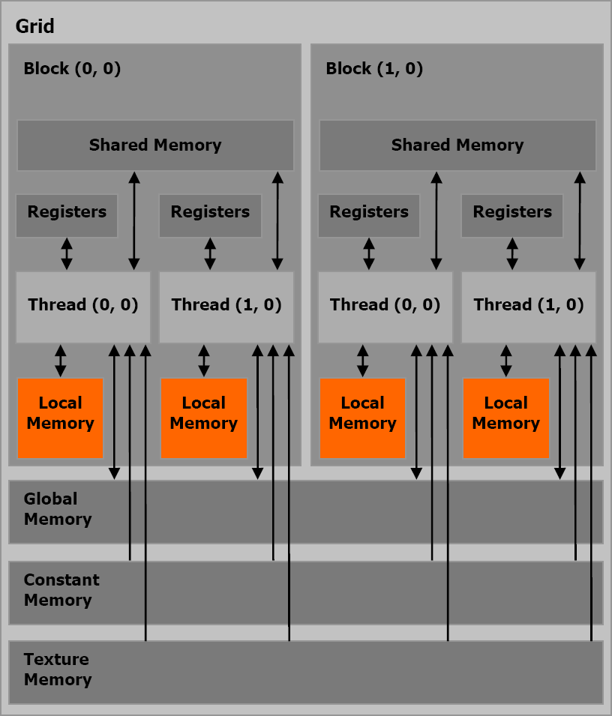
Memory Model
There are 6 Memory Types :
  Registers
  Local Memory
    in DRAM
    slow
    non-cached
    per thread
    relative large

Slide 33
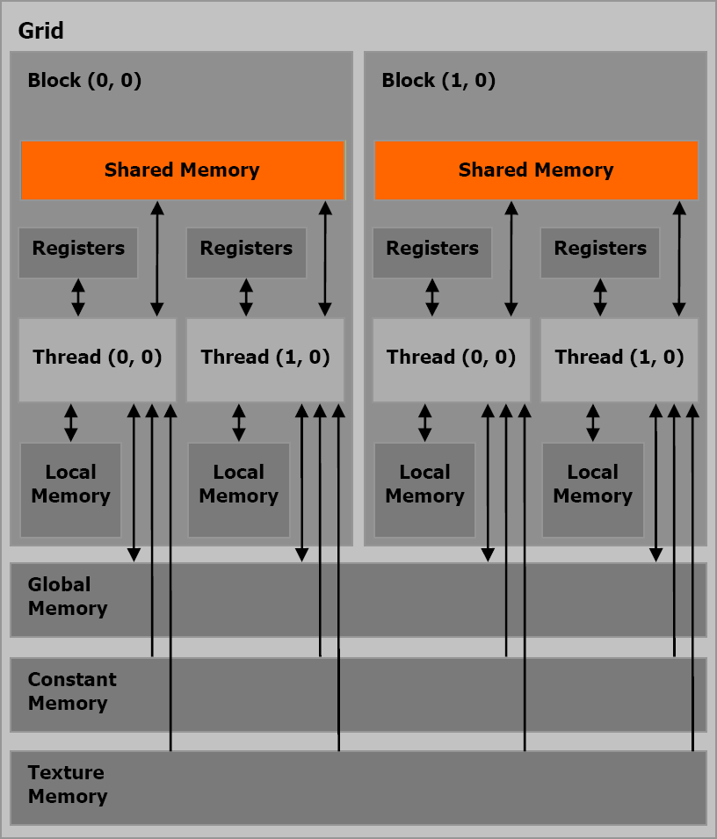
Memory Model
There are 6 Memory Types :
  Registers
  Local Memory
  Shared Memory
    on chip
    fast access
    per block
    16 KByte
    synchronize between threads

Slide 34
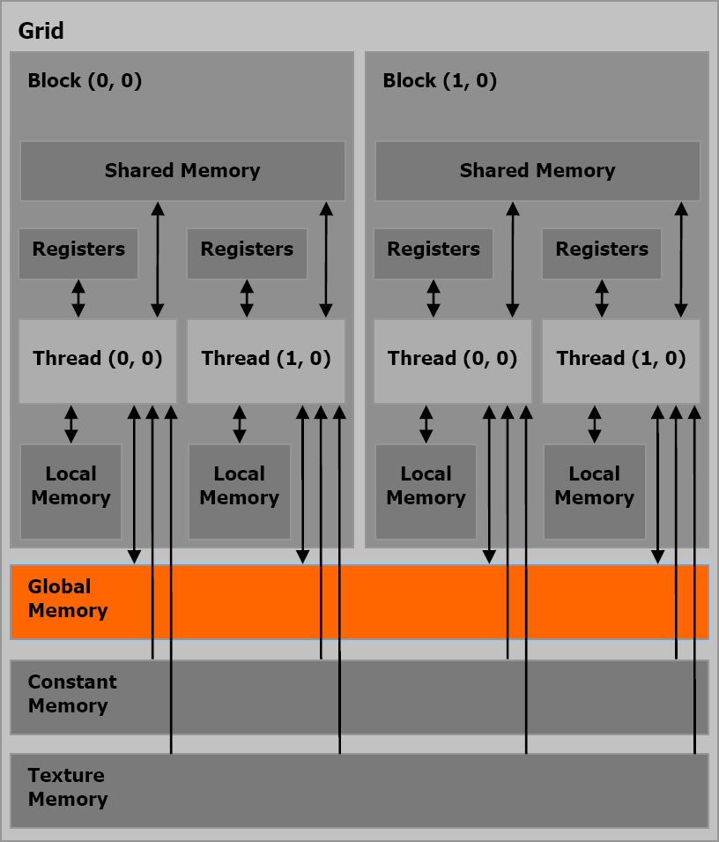
Memory Model
There are 6 Memory Types :
  Registers
  Local Memory
  Shared Memory
  Global Memory
    in DRAM
    slow
    non-cached
    per grid
    communicate between grids

Slide 35
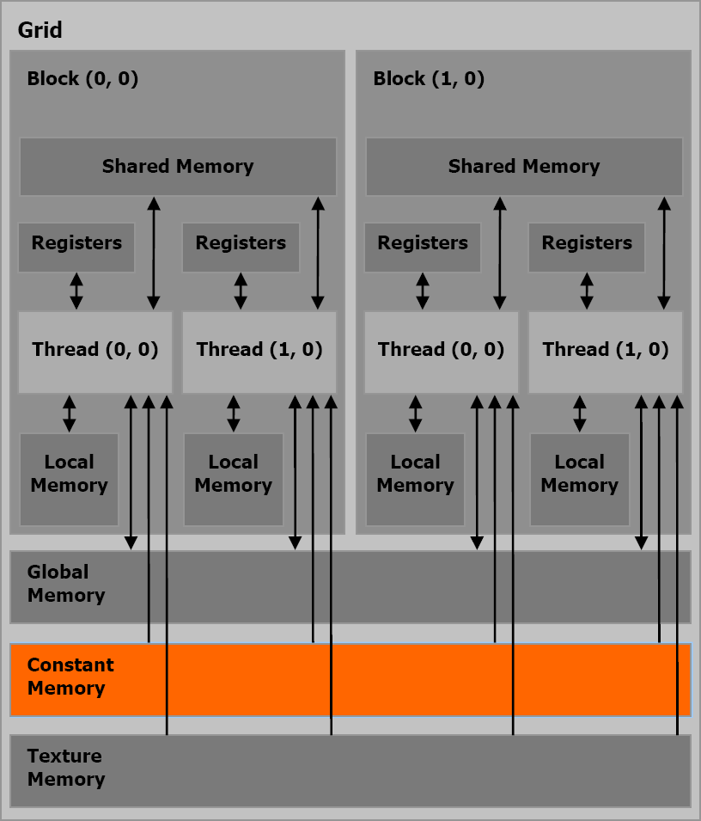
Memory Model
There are 6 Memory Types :
  Registers
  Local Memory
  Shared Memory
  Global Memory
  Constant Memory
    in DRAM
    cached
    per grid
    read-only

Slide 36
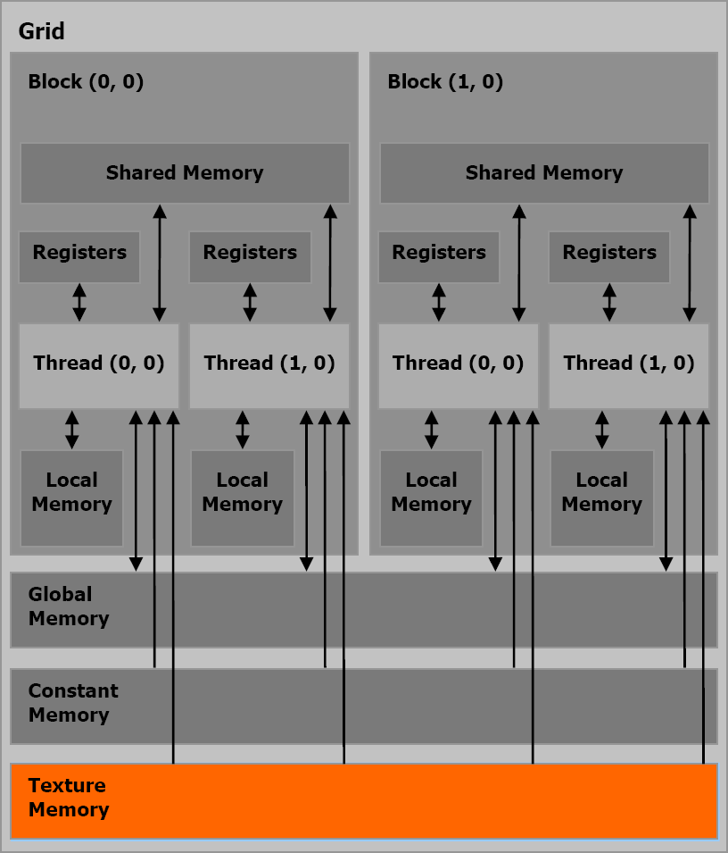
Memory Model
There are 6 Memory Types :
  Registers
  Local Memory
  Shared Memory
  Global Memory
  Constant Memory
  Texture Memory
    in DRAM
    cached
    per grid
    read-only

Slide 37
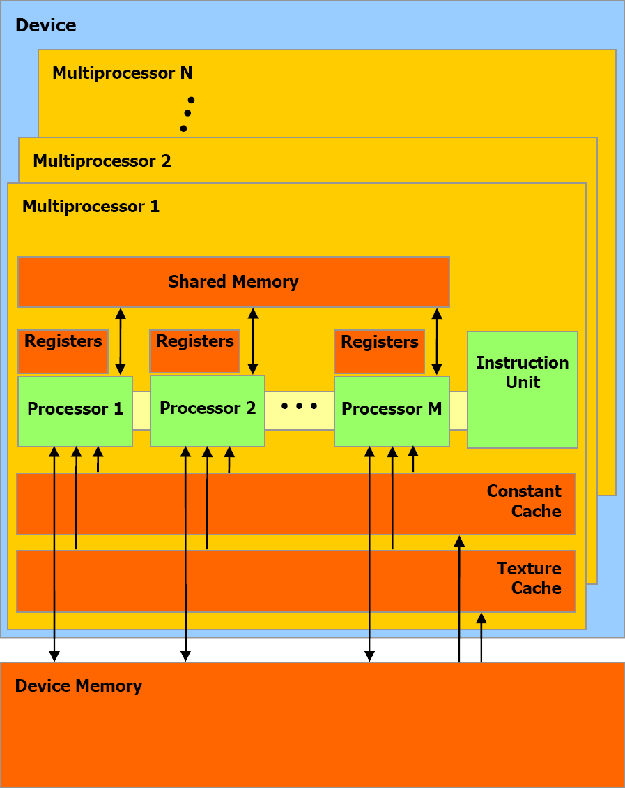
Memory Model
  Registers
  Shared Memory
    on chip
  Local Memory
  Global Memory
  Constant Memory
  Texture Memory
    in Device Memory

Slide 38
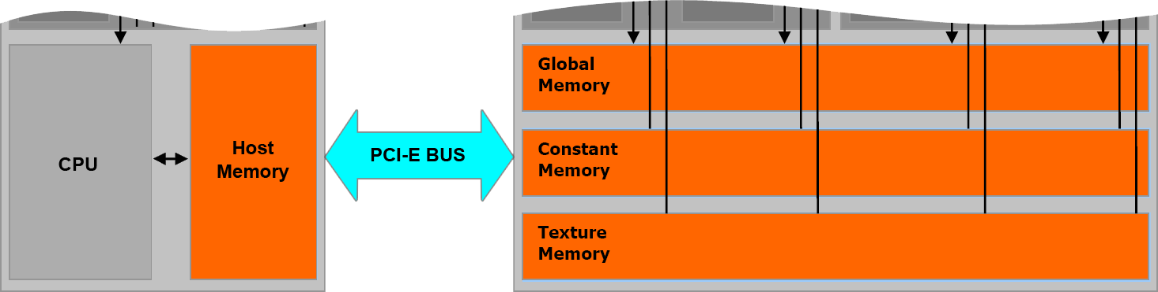
Memory Model
  Global Memory
  Constant Memory
  Texture Memory
    managed by host code
    persistent across kernels

Slide 39
Outline
  Introduction
  Motivation
  Programming Model
  Memory Model
  CUDA API
  Example
  Pro & Contra
  Trend

Slide 40
CUDA API
CUDA API provides a easily path for users to write programs for GPU device .
It consists of:
  A minimal set of extensions to C/C++
    type qualifiers
    call-syntax
    build-in variables
  A runtime library to support the execution
    host component
    device component
    common component

Slide 41
CUDA API
CUDA C/C++ Extensions:
  New function type qualifiers
__host__ void HostFunc(...); //executable on host
__global__ void KernelFunc(...); //callable from host
__device__ void DeviceFunc(...); //callable from device only
    Restrictions for device code (__global__ / __device__)
      no recursive call
      no static variable
      no function pointer
      __global__ function is asynchronous invoked
      __global__ function must have void return type

Slide 42
CUDA API
CUDA C/C++ Extensions:
  New variable type qualifiers
__device__ int GlobalVar; //in global memory, lifetime of app
__const__ int ConstVar; //in constant memory, lifetime of app
__shared__ int SharedVar; //in shared memory, lifetime of blocks
    Restrictions
      no external usage
      only file scope
      no combination with struct or union
      no initialization for __shared__

Slide 43
CUDA API
CUDA C/C++ Extensions:
  New syntax to invoke the device code
KernelFunc<<< Dg, Db, Ns, S >>>(...);
    Dg: dimension of grid
    Db: dimension of block
    Ns: optional, shared memory for external variables
    S : optional, associated stream
  New build-in variables for indexing the threads
    gridDim: dimension of the whole grid
    blockIdx: index of the current block
    blockDim: dimension of each block in the grid
    threadIdx: index of the current thread

Slide 44
CUDA API
CUDA Runtime Library:
  Common component
    Vector/Texture Types
    Mathematical/Time Functions
  Device component
    Mathematical/Time/Texture Functions
    Synchronization Function
      __syncthreads()
    Type Conversion/Casting Functions

Slide 45
CUDA API
CUDA Runtime Library:
  Host component
    Structure
      Driver API
      Runtime API
    Functions
      Device, Context, Memory, Module, Texture management
      Execution control
      Interoperability with OpenGL and Direct3D

Slide 46
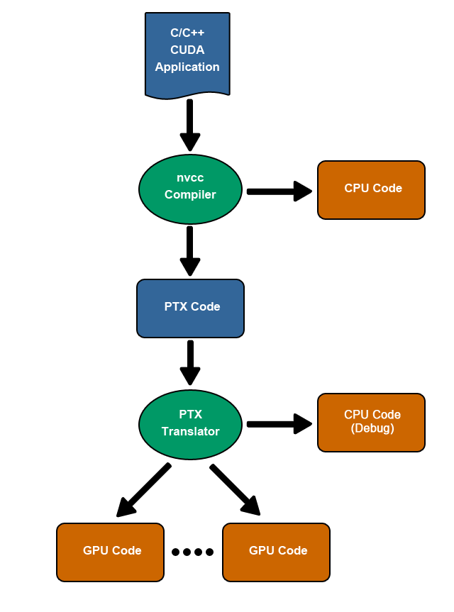
CUDA API
The CUDA source file uses .cu as extension. It contains host and device source codes.
The CUDA Compiler Driver nvcc can compile it and generate CPU/PTX binary code.
(PTX: Parallel Thread Execution, a device independent VM code)
PTX code may be further translated for special GPU-Arch.

Slide 47
Outline
  Introduction
  Motivation
  Programming Model
  Memory Model
  CUDA API
  Example
  Pro & Contra
  Trend

Slide 48
Programming Model
Simple example ( Matrx addition ):
cpu c program: cuda program:

Slide 49
Outline
  Introduction
  Motivation
  Programming Model
  Memory Model
  CUDA API
  Example
  Pro & Contra
  Trend

Slide 50
Pro & Contra
CUDA allows
  massive parallel computing
  with a relative low price
  high integrated solution
  personal supercomputing
  ecofriendly production
  easy to learn

Slide 51
Pro & Contra
Problem ......
  slightly low precision
  limited support for IEEE-754
  no recursive function call
  hard to use for irregular join/fork logic
  no concurrency between jobs

Slide 52
Outline
  Introduction
  Motivation
  Programming Model
  Memory Model
  CUDA API
  Example
  Pro & Contra
  Trend

Slide 53
Trend
  More cores on-chip
  Better support for float point
  Flexiber configuration & control/data flow
  Lower price
  Support higher level programming language

Slide 54
References
[1] CUDA Programming Guide, nVidia Corp.
[2] The CUDA Compiler Driver, nVidia Corp.
[3] Parallel Thread Execution, nVidia Corp.
[4] CUDA: A Heterogeneous Parallel Programming Model for Manycore Computing, ASPLOS 2008, gpgpu.org

Slide 55
Question?

